Slide 1
CME
Channel
Marketing
Expense System
How to request account,
forgot password and change password

Slide 2
Things to
prepare before
training
Username & Password
For login to system
Proposal’s
Document Support

Slide 3
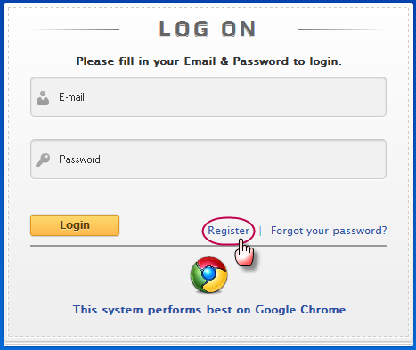
Go to
http://cme.doubleapaper.com
For new coming user, you need to request account before log-in to the system by 1. Go to http://cme.doubleapaper.com 2. Click “Register”

Slide 4
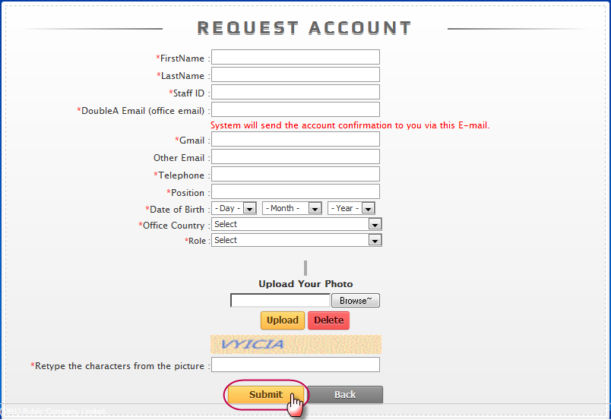
Request Account (1)
Fulfill your profile, upload your photo then click “Submit”

Slide 5
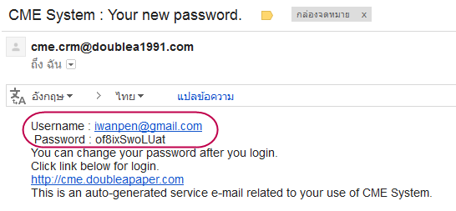
Request Account (2)
The confirm message will be show after your request was complete.
After the Admin approve your account, the system will be send the username and password to your email.

Slide 6
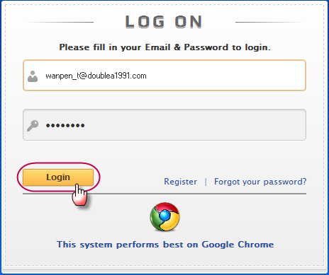
Request Account (3)
Go to http://cme.doubleapaper.com
and use the username and password to log-in

Slide 7
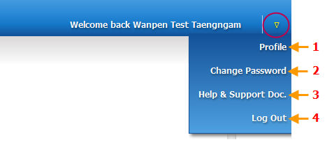
Home page (1)
After log-in, the system will redirect to homepage where you can see your relate proposals. And you can manage your profile by click at the triangle menu
1. View and edit your profile
2. Change password (require to change password after first login)
3. Download the user manual
4. Log Out (require to click log out especially the public computer)

Slide 8
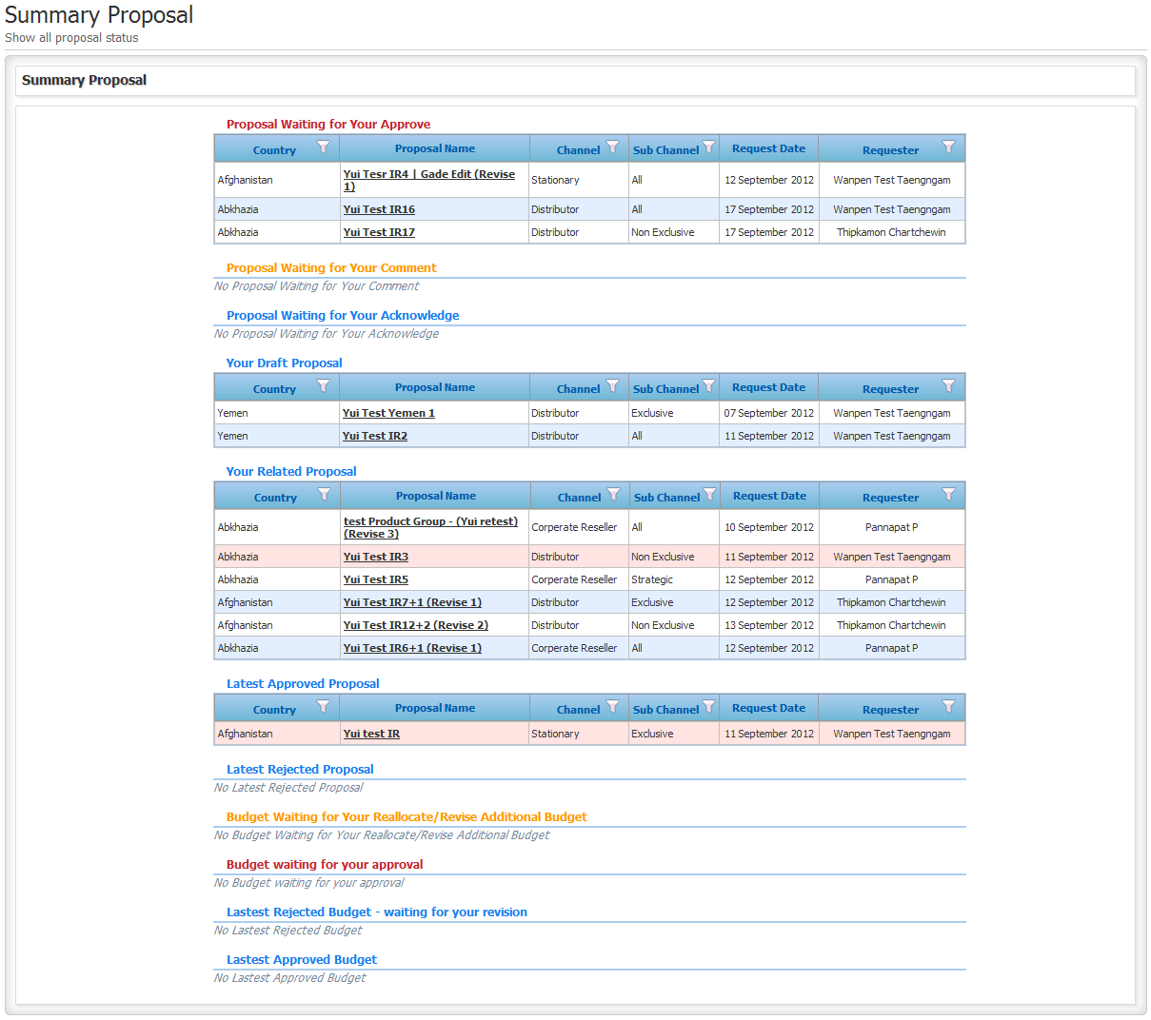
Home Page (2)
At the home page, there will show your relate proposal
that show in different table/process.

Slide 9
Home Page (3)
The proposal detail will show as below,
1. Proposal’s country
2. Proposal name – You can click at proposal name to view full proposal detail
3. Channel
4. Sub-Channel
5. Request date – Submit proposal date
6. Requester

Slide 10
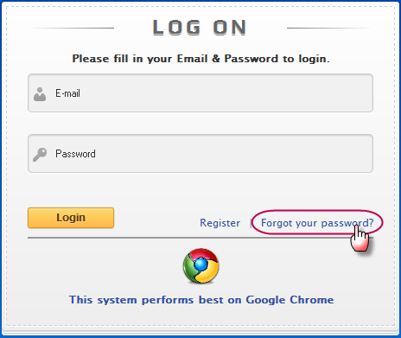
Forgot Password (1)
If you forgot your password, you can ask the system to send new password to your email by click “Forgot your password”

Slide 11
Forgot Password (2)
Fill your email and click “Send new password to my E-mail”

